Slide 1
Lecture 4 Visualizing & standardizing serological data
May 22, 2025
Seroanalytics Training Blantyre, Malawi

Slide 2
Lecture outline
Data visualization
Why binarize serological data?
Converting MFI values to standardized units (IU/mL)
Applying an externally-defined cutoff to calculate seroprevalence
Calculating confidence intervals for seroprevalence

Slide 3
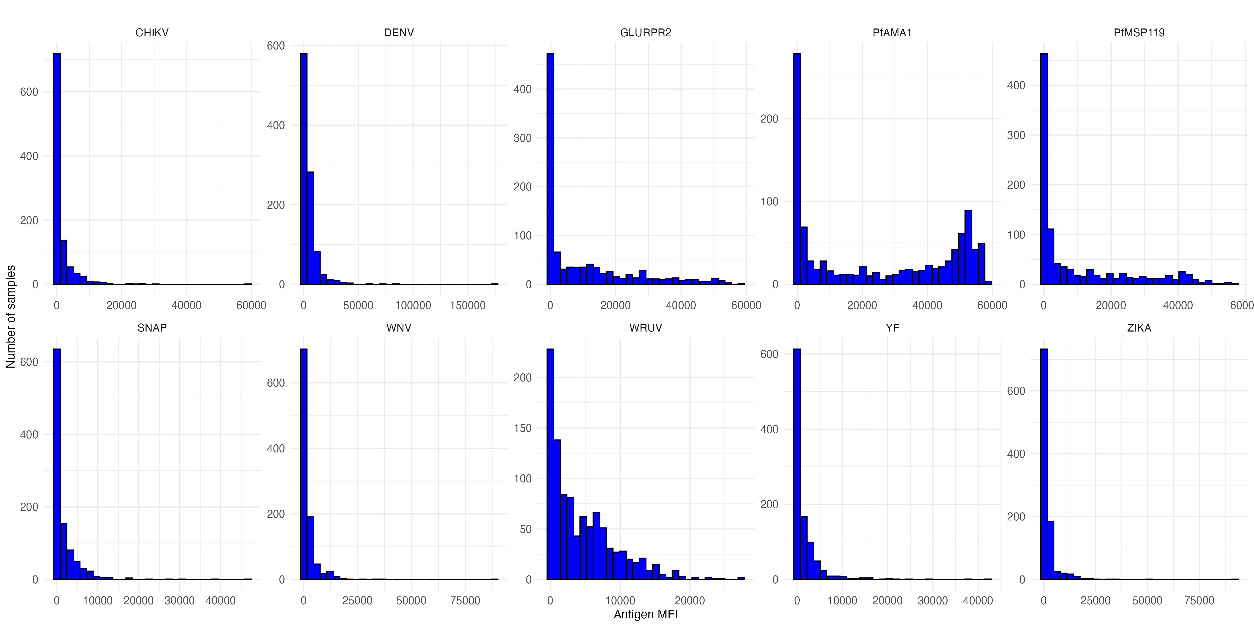
Visualizing serological data with histograms
How would you compare the different distributions of data (untransformed)?

Slide 4
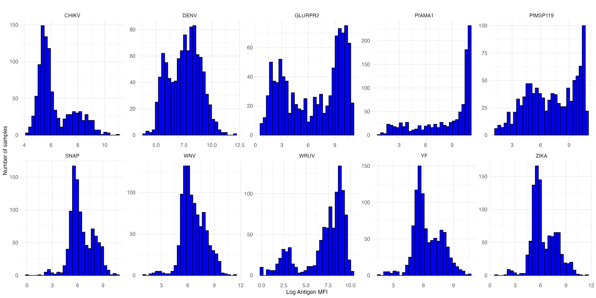
Visualizing serological data with histograms
How would you compare the different distributions of data (log transformed)?

Slide 5
Visualizing serological data with histograms
How would you compare the different distributions of data?
Skewed vs. non-skewed distributions
Unimodal vs. bimodal vs. multimodal
Narrow or wide distribution
Are there outliers?

Slide 6
Visualizing serological data with histograms
What underlying differences might cause the different distributions of data?

Slide 7
Visualizing serological data with histograms
What underlying differences might cause the different distributions of data?
Mix of exposed and unexposed in population
Mix of vaccinated / unvaccinated
Waning antibody responses

Slide 8
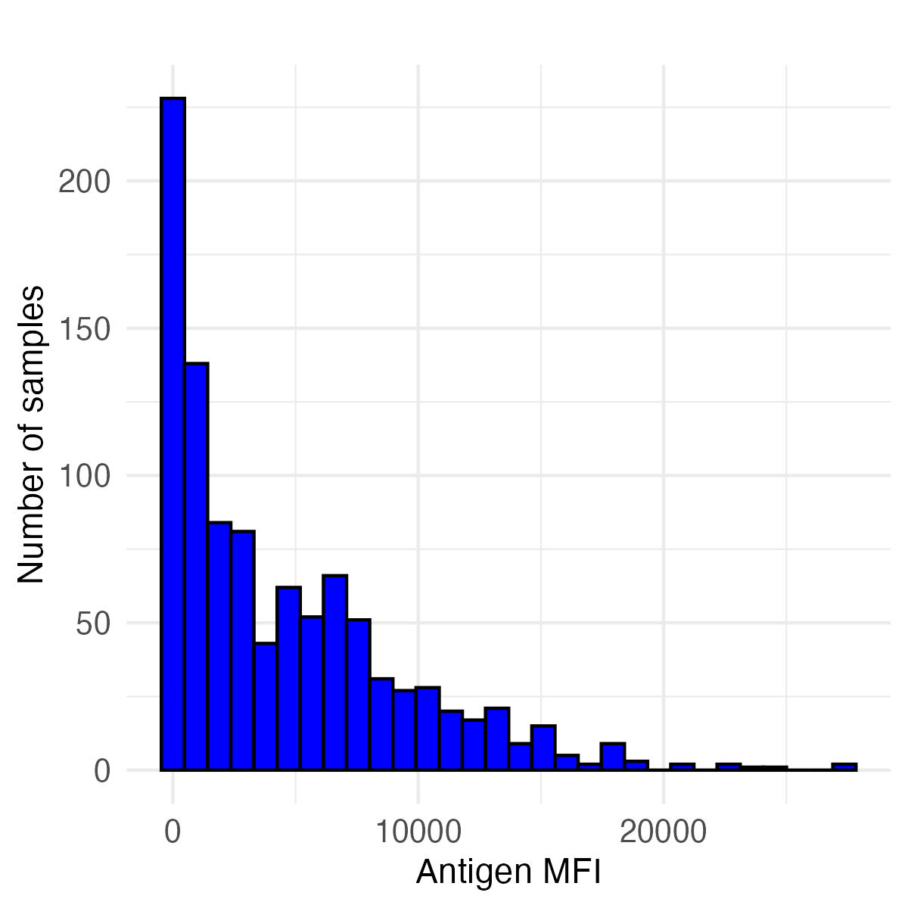
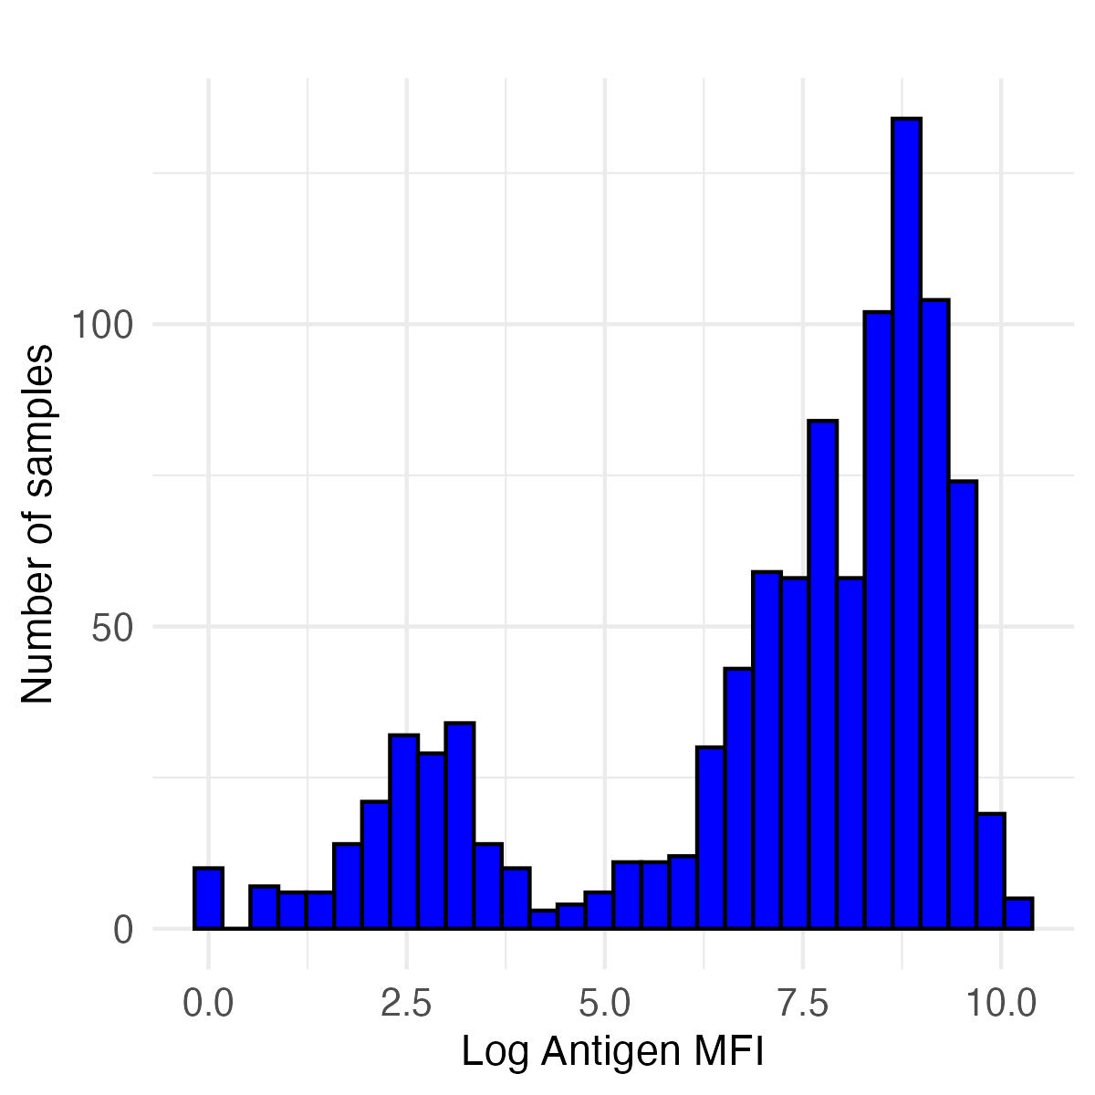
Histograms of rubella antibody responses
Untransformed MFI Values Log transformed MFI values
How do we get information from histograms like these?
How do we compare the results of different histograms?
What inferences can we make about pathogen exposure based on a histogram?
A method of making inferences from distributions is binarizing data
Setting a cutoff, and everything above that cutoff is positive

Slide 9
Histograms of rubella antibody responses
Untransformed MFI Values Log transformed MFI values
Rubella has a correlate of protection
Individuals with antibody responses above a certain cutoff are expected to be protected from rubella infection
By applying a cutoff equivalent to the correlate of protection, we can calculate seroprevalence (here, also equals the immune proportion)

Slide 10
Histograms of rubella antibody responses
Untransformed MFI Values Log transformed MFI values
Rubella correlate of protection is 9.36 IU/mL (international units per milliliter)
However, the Luminex assay gives us antibody units in MFI (median fluorescence intensity)
We can convert from MFIs to IU/mL using a standard curve: we convert all MFI values to IU/mL, and apply the 9.36 IU/mL cutoff

Slide 11

Converting MFI values to standardized units (IU/mL) from standard curves
The standard curve is created using known concentrations of antibody standards (e.g., the WHO International Standard for rubella, below), ideally measured on the same plate(s) as the unknown samples.
https://nibsc.org/documents/ifu/RUBI-1-94.pdf

Slide 12
Converting MFI values to standardized units (IU/mL) from standard curves
(Recall we used standard curves to estimate relative antibody units.)
First, we fit a model to our standard curve data to establish the relationship between MFI values and known IU/mL concentrations.
Then, we can use this model to convert MFI values for the samples of interest to values in IU/mL.
Lastly, we apply the 9.36 IU/mL correlate of protection cutoff to the samples of interest to determine a binary serostatus for each sample.
Notes:
Please note that the cutoff value of rubella 9.36IU/mL comes from the following analysis: https://pmc.ncbi.nlm.nih.gov/articles/PMC8316076/ wherein “the ROC analysis for the RuV WVA MBA was performed on 152 paired serum samples (Table 1), using the quantitative ELISA as a classifier and resulted in an AUC of 1, a sensitivity of 99%, and a specificity of 100%, with a cutoff of 9.36 IU/mL (Fig. 8E)."

Slide 13
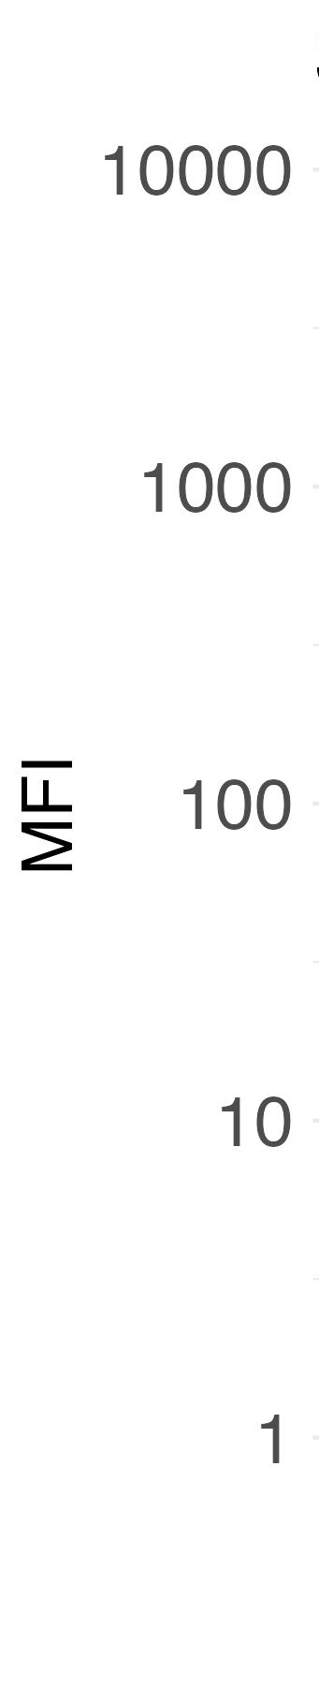
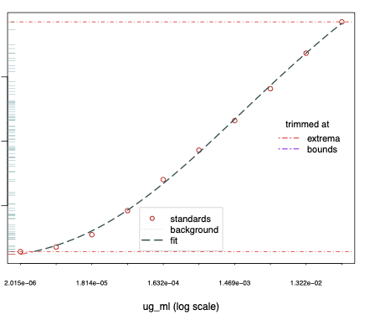
Converting MFI values to standardized units (IU/mL) from standard curves
For rubella (the “WRUV” antigen), we can apply the cutoff (based on correlate of protection) of 9.36 IU/mL to determine individual serostatus.
cutoff (9.36 IU/mL)
observed sample data
1 10 100
WRUV concentration (IU/mL)

Slide 14
Determining serostatus from a cutoff
For each sample in the dataset, we convert the MFI value to a concentration value (IU/mL), and then classify each sample as seropositive (1) or seronegative (0)
Sample ID | WRUV MFI | WRUV IU/mL | Serostatus
1 | MFI_1 | conc_1 | 1
2 | MFI_2 | conc_2 | 1
3 | MFI_3 | conc_3 | 0
4 | MFI_4 | conc_4 | 1
5 | MFI_5 | conc_5 | 1
6 | MFI_6 | conc_6 | 0
7 | MFI_7 | conc_7 | 0

Slide 15
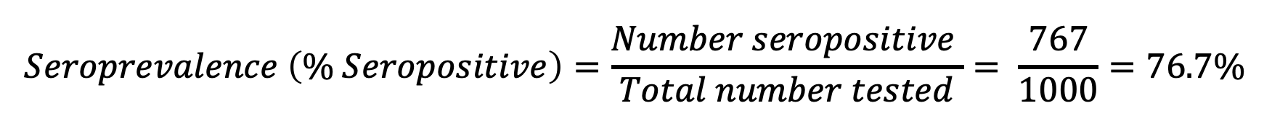
Calculating seroprevalence
For WRUV, with a cutoff of 9.36 IU/mL, we have:
767 seropositive samples
233 seronegative samples
$$Seroprevalence \left(\% Seropositive\right)=\frac{Number seropositive }{Total number tested}= \frac{767}{1000}=76.7\%$$

Slide 16
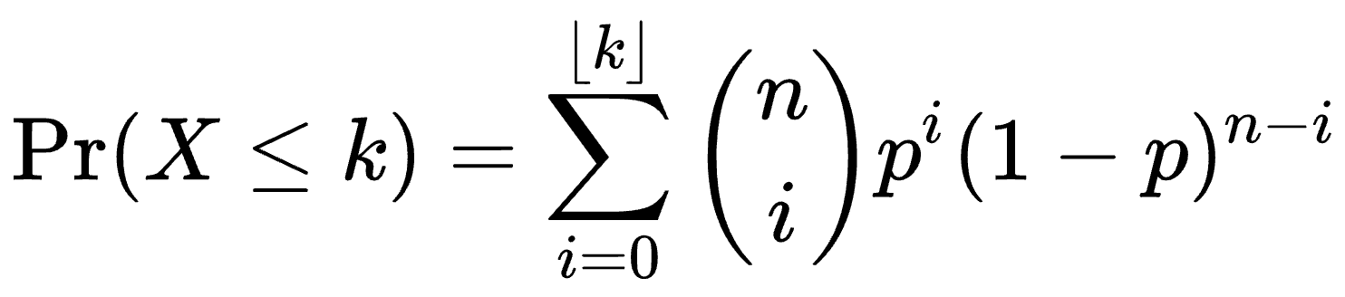
Calculating seroprevalence – confidence intervals
Estimating uncertainty is important for capturing true population seroprevalence; it typically accounts for variance around a mean estimate.
Estimating a 95% confidence interval means that in 95 out of 100 calculations of seroprevalence from the same source population using 1000 individuals, the range will include the true population-level seroprevalence.
This method uses a binomial distribution and accounts for the number of people sampled – luckily, we can use R to easily compute it:

Slide 17
Calculating seroprevalence – confidence intervals
With 767 seropositives and 1000 total samples:
Seroprevalence = 76.7% (95% CI: 74.0%, 79.3%)

Slide 18
Question: How do we interpret seroprevalence?
Interpretation strongly depends on how seroprevalence is determined, including controls used and selected cutoff.
For the seroprevalence of rubella (WRUV):
Percentage of people who have been exposed to vaccine or natural infection.
If we know there’s no/little vaccination, we may assume seroprevalence is wholly due to natural infection, or vice versa.
Since cutoff is a correlate as protection, seroprevalence could also indicate which individuals are susceptible to future infection, and whether there could be outbreaks in a region.

Slide 19
Question: How do we interpret seroprevalence?
How would we interpret seroprevalence if there is NOT a correlate of protection? (see Part 5)

Slide 20
Question: How do we interpret seroprevalence?
How would we interpret seroprevalence if there is NOT a correlate of protection? (see Part 5)
For antigens in general, seropositivity could indicate:
Population who has ever been exposed to pathogen or vaccine
Population who has had recent infection
Population who has had symptomatic infection
Cross-reactive antibody responses

Slide 21
Conclusions
You should visualize your data before conducting analysis.
It can be useful to classify samples as seropositive and seronegative for direct interpretation of serological results.
For some pathogens, the existence of externally-defined correlates of protection and the availability of (international) antibody standards make it straightforward to calculate and interpret seroprevalence. This is not the case for all pathogens!
We can use a statistical model to produce confidence intervals around the mean seroprevalence estimate.

